Slide 1
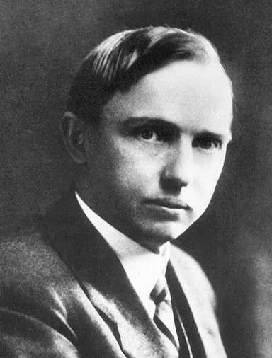
Famous
Astronomers
Harlow Shapley
Globular Star Clusters

Slide 2
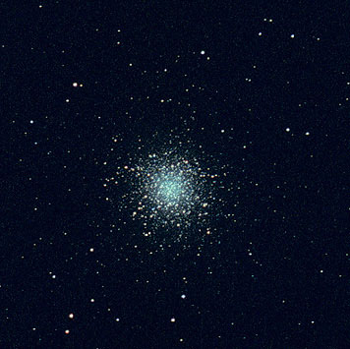
M13 Through the Telescope
M13 is 25,100 light years away from us.

Slide 3
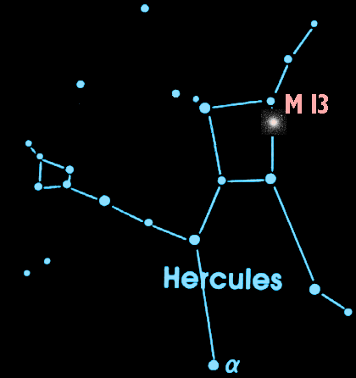
M13 is in the Night Sky
A dark night and a good pair of binoculars can help you catch a glimpse of this cluster of stars in the constellation Hercules.

Slide 4
What is M13?
M13 is a globular cluster over 150 light years across and it contains about 1,000,000 stars.

Slide 5
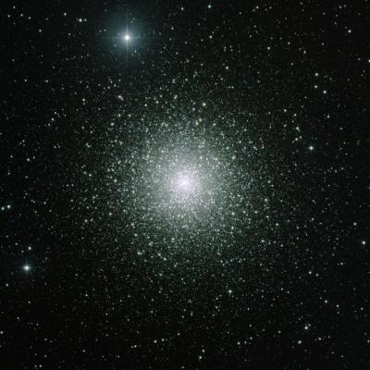
What is a Globular Cluster?
A globular cluster is a tightly packed group of about 100,000 stars. There are roughly 150-200 globular clusters in the Milky Way.

Slide 6
How Big are Globular Clusters?
150 light years
M13 is 150 light years across. At the speed of light (186,000 mi/sec) it takes 150 years for light to cross M13 from one side to the other. – That’s 2 lifetimes!

Slide 7
How Old Are Globular Clusters?
The globular clusters of our Milky Way are old! They are the same age as the galaxy itself – at least 12 billion years old.

Slide 8
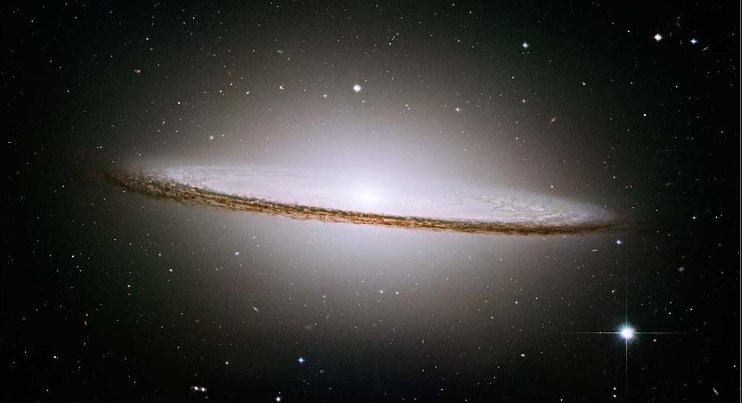
Star Clusters 101
Star Clusters 101
Globular clusters orbit above and below the plane of the galaxy.
globular clusters
halo
Central bulge
disk
disk

Slide 9
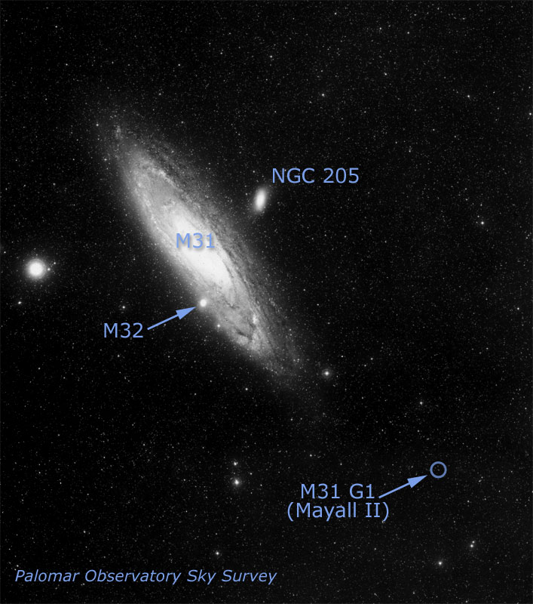
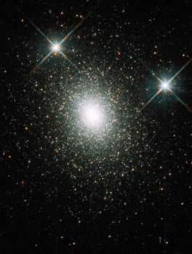
Other Galaxies Have Halos of Globular Clusters
HST image of G1
This globular cluster called G1 is in the halo of the Andromeda galaxy (M31).
This globular has a medium-sized black hole in it!

Slide 10
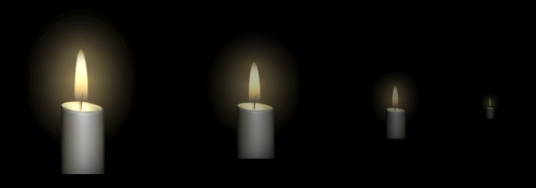
Standard Candles
Some types of stars are very useful for determining distances in space because they have a known luminosity and can be seen from very far away. These are called “standard candles”.

Slide 11
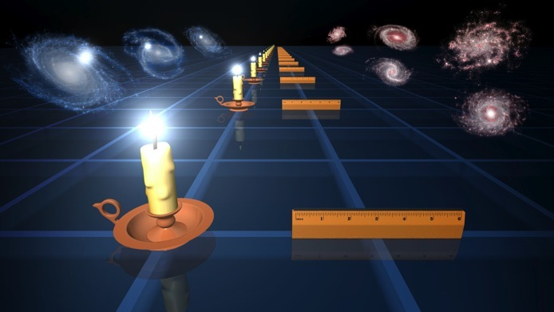
Standard Candles
If we know how bright an object in space actually is and compare it to how bright it appears, we can calculate how far away it is.

Slide 12
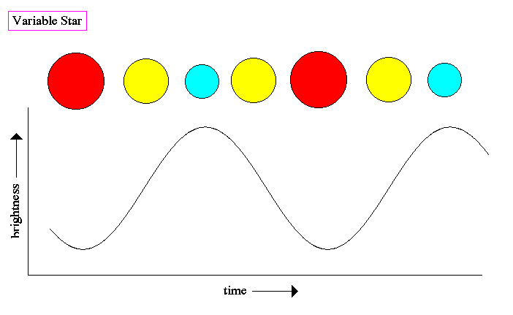
Harlow Shapley
The “standard candle” that Harlow Shapley used to find the distance to globular clusters are called Cepheid variables. They pulsate at a very regular period that is directly related to their luminosity.

Slide 13
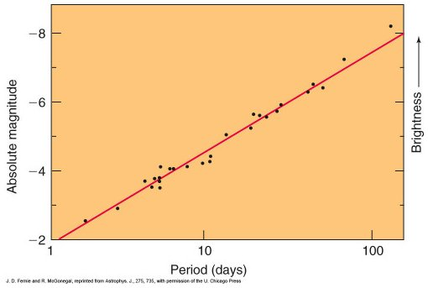
Harlow Shapley
This means that the longer the period, the brighter the stars actually are. This is referred to as the period-luminosity relationship

Slide 14
Harlow Shapley
Shapley used this period-luminosity relationship of Cepheid variable stars to determine the distances to globular clusters.

Slide 15
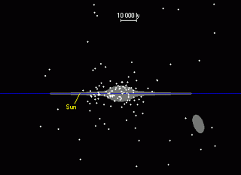
Harlow Shapley
Due to Shapley’s work measuring the distances to globular clusters, he also realized that the Milky Way Galaxy was much larger than previously believed and he determined our Sun’s approximate position in the galaxy.

Slide 16
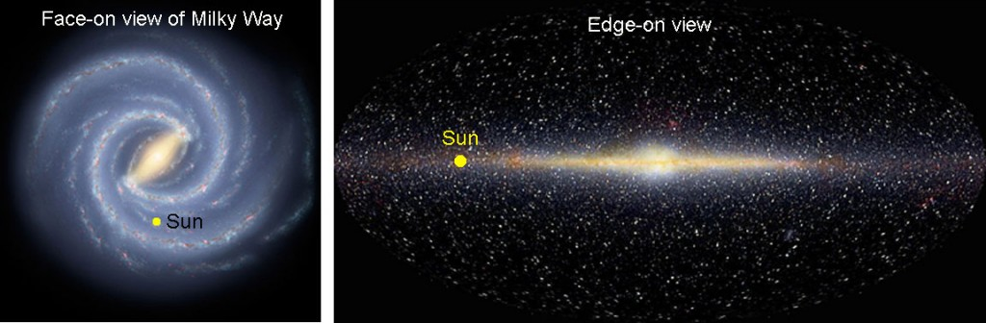
Harlow Shapley
Due to Shapley’s work measuring the distances to globular clusters, he also realized that the Milky Way Galaxy was much larger than previously believed and he determined our Sun’s approximate position in the galaxy.

